Slide 1

Presentation on
Network Sniffing with Wireshark Similar Tool
Submitted to: Submitted by:
Dr. Vasudevan A. R. Abhijeet Kumar Singh
Department of CSED M190675CA
Ashish Kumar Sahu
M190365CA
Abhilasha Sharma
M180275CA

Slide 2
What is Sniffing
Sniffing is the process of monitoring and capturing all data packets that are passing through a computer network using packet sniffers.
Attackers use sniffers to capture data packets containing sensitive information such as password, account information etc but usually used by network administrators to monitor and troubleshoot the network traffic.
To avoid sniffing, users should avoid connecting to unsecured networks, which includes free public Wi-Fi. These unsecured networks are dangerous since an attacker can deploy a packet sniffer that can sniff the entire network.

Slide 3
Types of Sniffing
There are two types of sniffing:
a) Active sniffing : Sniffing in the switch is active sniffing. A switch is a point to point network device. The switch regulates the flow of data between its ports by actively monitoring the MAC address on each port, which helps it pass data only to its intended target. In order to capture the traffic between target sniffers has to actively inject traffic into the LAN to enable sniffing of the traffic.
b) Passive sniffing : passive sniffing uses hubs instead of switches. Hubs perform the same way as switches only that they do use MAC address to read the destination ports of data. All an attacker needs to do is to simply connect to LAN and they are able to sniff data traffic in that network.

Slide 4
What is Packet Sniffing
Packet sniffing is the practice of gathering, collecting, and logging some or all packets that pass through a computer network, regardless of how the packet is addressed.
These packets are intended for — and addressed to — specific machines, but using a packet sniffer in "promiscuous mode" allows IT professionals, end users or malicious intruders to examine any packet, regardless of destination.
It's possible to configure sniffers in two ways. The first is "unfiltered," meaning they will capture all packets possible and write them to a local hard drive for later examination. Next is "filtered" mode, meaning analyzers will only capture packets that contain specific data elements.

Slide 5

What is Wireshark
Wireshark is a free and open source network protocol analyzer that enables users to interactively browse the data traffic on a computer network.
Wireshark is basically used for used for education, analysis, software development, communication protocol development, and network troubleshooting.

Slide 6
References
https://blog.eccouncil.org/what-are-sniffing-attacks-and-their-types/
https://www.greycampus.com/opencampus/ethical-hacking/sniffing-and-its-types#:~:text=Sniffing%20is%20a%20process%20of,as%20password%2C%20account%20information%20etc.
https://www.kaspersky.com/resource-center/definitions/what-is-a-packet-sniffer
https://www.paessler.com/it-explained/packet-sniffing

Slide 7
How to use Wireshark

Slide 8
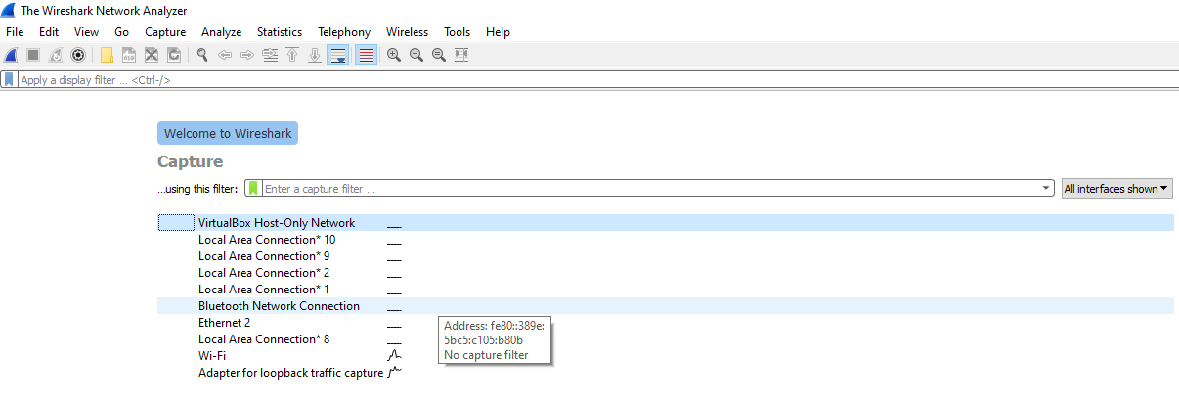
Step 1: First Page of Wireshark

Slide 9
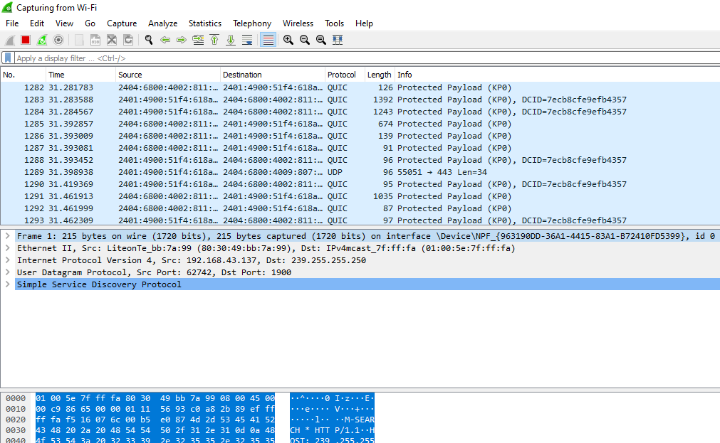
Step 2 : below is the list of all the traffic flowing through the system Wi-fi network interface

Slide 10
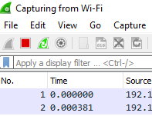
Step 3: After some time stop the capturing of packets
After Clicking on the Red button it will stop the capturing and a list of captured packets is available.

Slide 11
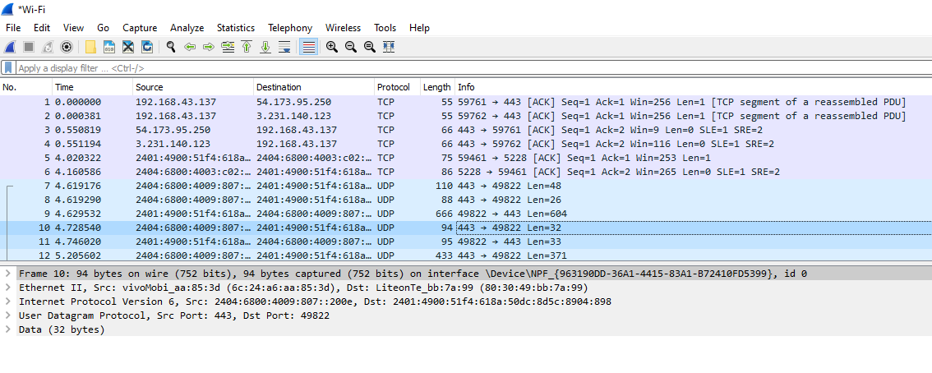
Step 4: Here we can see a complete list of all the captured packets that are ready to analyze

Slide 12
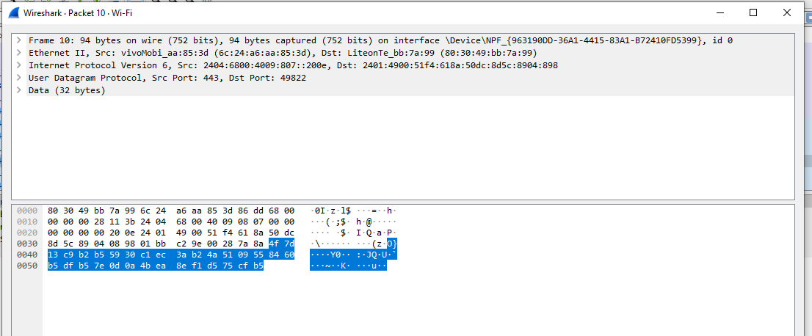
Double click on any captured packet to get the details of that packet.
Source IP, Destination IP,
Protocol used, etc

Slide 13
Implementation Of Tool that Capture Network Packets

Slide 14
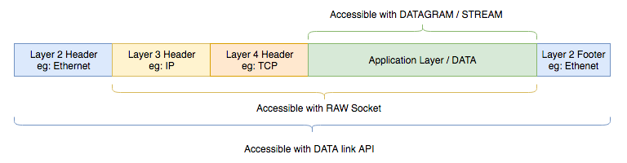
Some libraries that we use (in our python tool)
A simple packet sniffer in Python can be created with the help socket module. We can use the raw socket type to get the packets. A raw socket provides access to the underlying protocols, which support socket abstractions. Since raw sockets are part of the internet socket API, they can only be used to generate and receive IP packets.
Socket Packet Capture

Slide 15

scapy
Scapy is a powerful interactive packet manipulation program. It is able to forge or decode packets of a wide number of protocols, send them on the wire, capture them, match requests and replies, and much more. It can easily handle most classical tasks like scanning, tracerouting, probing, unit tests, attacks or network discovery (it can replace hping, 85% of nmap, arpspoof, arp-sk, arping, tcpdump, tethereal, p0f, etc.).

Slide 16
struct
The struct module in Python is used to convert native Python data types such as strings and numbers into a string of bytes and vice versa. What this means is that users can parse binary files of data stored in C structs in Python.
It is used mostly for handling binary data stored in files or from network connections, among other sources.

Slide 17
OS Package
The OS module in Python provides functions for interacting with the operating system. OS comes under Python’s standard utility modules. This module provides a portable way of using operating system-dependent functionality. The *os* and *os.path* modules include many functions to interact with the file system.

Slide 18
Individual contribution of each Member

Slide 19
Member 1: Abhilasha Sharma
Contribution in creating the project:
Creating a pcap file when a new session for packet capture is created
Using socket to create connection
After capturing packet using Pcap class to store packet info
Showing real-time basic information of captured packet

Slide 20
Member 2: Ashish Shau
Contribution in creating the project:
Creating a Class “Pcap” that will take captured packet as input and store it in a “.pcap” file
Reading a “.pcap” from a given path
Printing all the information of packet captured
Ex: Source IP, Destination IP, Protocol, Raw Data, etc.

Slide 21
Member 3: Abhijeet Singh
Contribution in creating the project:
Packages that are required for working of project
Writing methods for showing real-time description on each captured packet
Ex: icmp_segment, tcp_segment,udp_segment etc methods
Designing basic structure of packet sniffer
Adding comments at the required places

Slide 22
Working of Sniffer

Slide 23
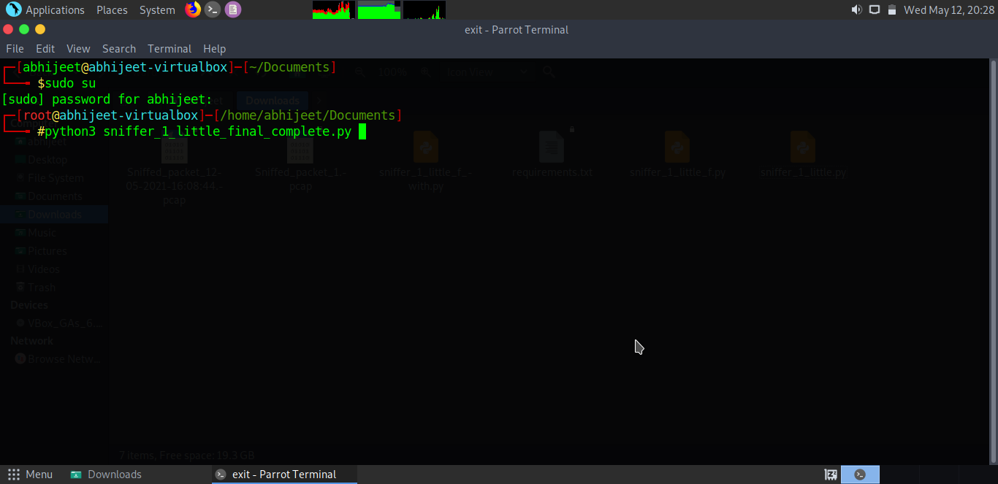
To run the project
To run the program you need root permissions.

Slide 24
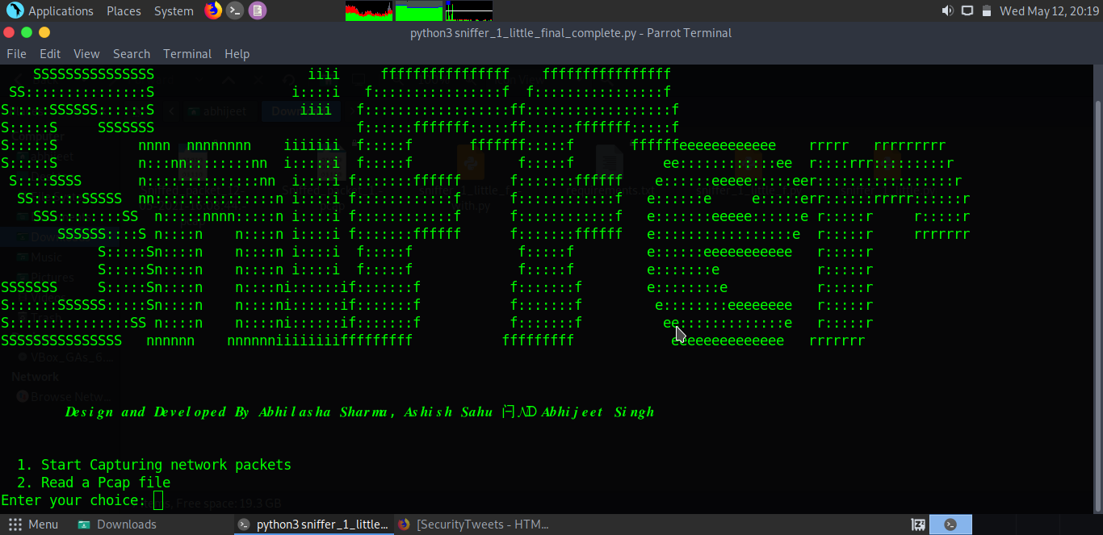
First Screen
Enter your choice :1
Enter Number of packets to capture:

Slide 25
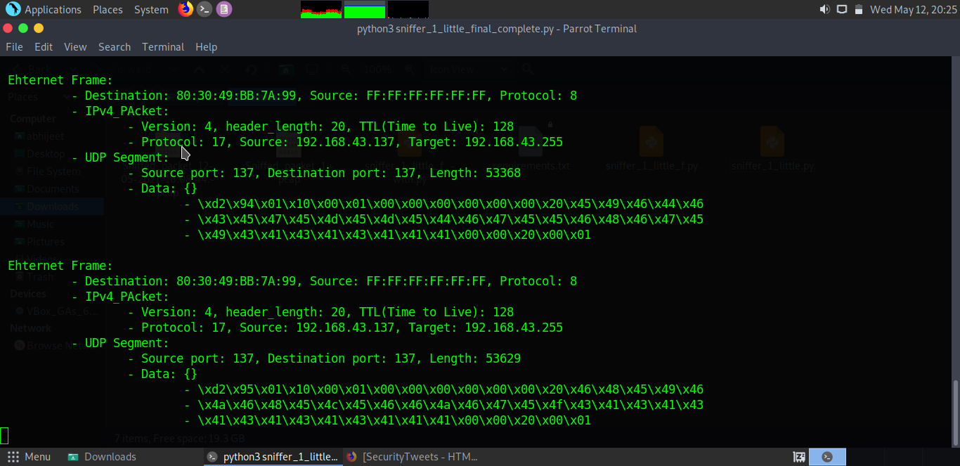
Capturing Packets
Now, The packets are being captured and stored in a pcap file.

Slide 26
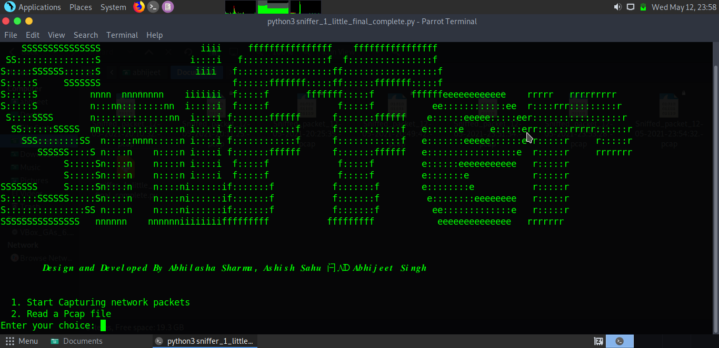
To Read the Pcap file
Enter your choice: 2

Slide 27
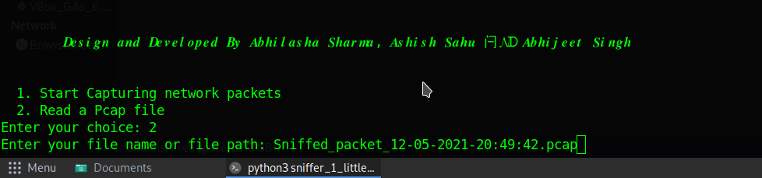
Give the path of Pcap file with its <filename.pcap>
Name of the file that we have to read

Slide 28
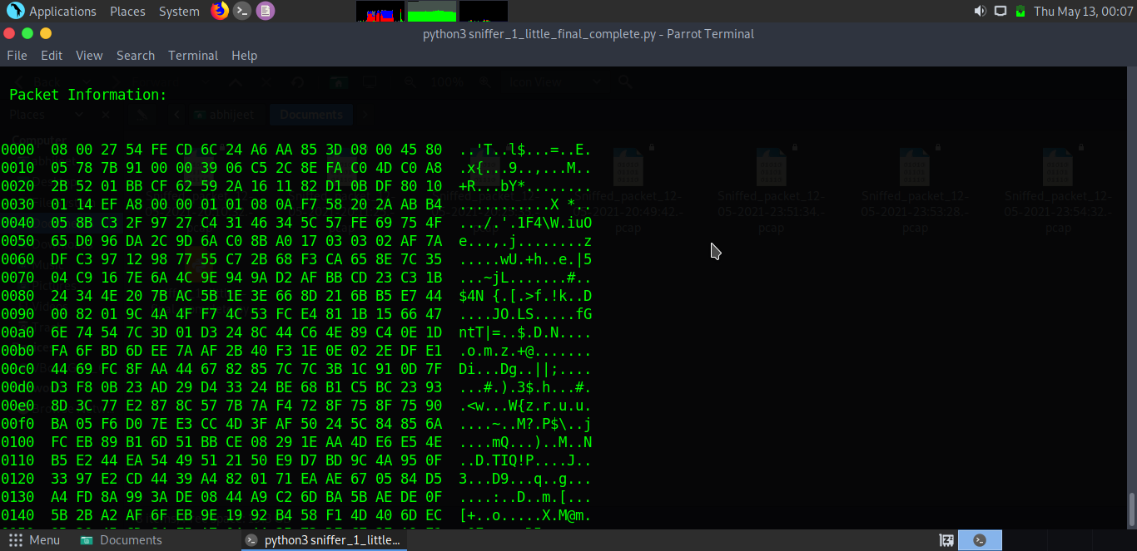
Data of a packet

Slide 29
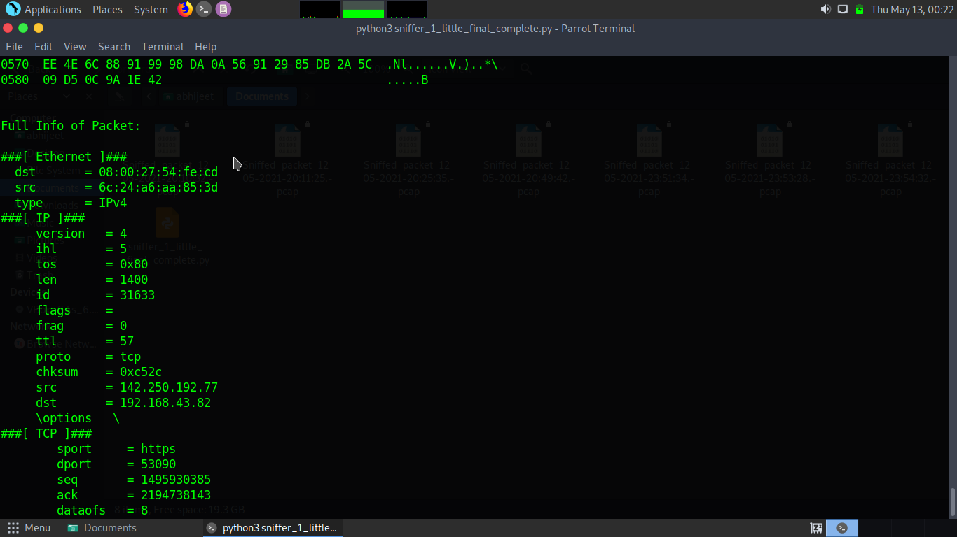
Detailed Information of captured packet with the help of
Scapy .show() function

Slide 30
References:
https://medium.com/@vworri/extracting-the-payload-from-a-pcap-file-using-python-d938d7622d71
https://subscription.packtpub.com/book/networking_and_servers/9781784399771/8/ch08lvl1sec48/reading-and-writing-to-pcap-files
https://cppsecrets.com/users/812115971219710810510797110971151014957494864103109971051084699111109/Python-Scapy-Reading-PCAP-file.php
https://youtu.be/WGJC5vT5YJo

Slide 31
Conclusion
The most important purpose of this project is to develop a nifty tool( or a software) that have the ability to sniff over the network and capture data packets that is around it. Analyze those packets and gain some informative data from it to compromise the systems on its range. It can also be used to monitor a user’s home network for activities that are being encapsulated in the process.

Slide 32
Thank You

